Slide 1
Analytical Methods : Survival Analysis
Feb’10

Slide 2
Topics
Survival Analysis Introduction
Survival Analysis Basics
SAS Procedures
PROC LIFEREG
PROC LIFETEST
PROC PHREG

Slide 3

Survival Analysis Introduction
Survival Analysis is the study of time to failure of a system or longevity
It may also be referred as failure-time modeling, duration analysis or reliability theory
It attempts to answer questions like :
What is the fraction of a population surviving after 80 years ?
What enhances the odds against dying early ?
At what rate something fails after a given period of time ?
The object of primary interest is the non increasing survival function/survivorship function conventionally denoted S which is defined as where t is some time & T is the time of death
Lifetime distribution function :
Event Density :

Slide 4
Survival Analysis : Basics
Censoring : Censored observations are those where the time to the event of interest (failure, death etc.) is outside the study/observation window or the data is unavailable For eg. Patient was alive while the drug study was closed, if t is the time to event,t₀ time of study
Right censoring if t>t₀
Left censoring, if subject is known to have t<t’ for a fixed t’
Truncated if for all t<t’ the observations are not studied at all
Interval Censored if t’’<t<t’
Hazard Function : The event rate at time t conditional on survival until time t or later (T ≥ t).
Cumulative Hazard Function conventionally denoted by Λ :
The parameters estimation is essentially a least square regression performed on transformed data

Slide 5
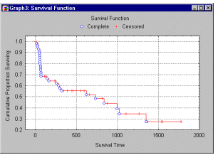
Survival Analysis : Basics
Life Table : It is an enhanced frequency table with survival times divided into intervals each containing the number of cases entering alive, number of failures, number of censors or lost. It enables to visualize the data and gain insights into the overall distribution.
Kaplan Meier Curve : It is equivalent to a life table in which each time interval contains exactly one observation. Multiplying the probabilities across each interval gives the survival function S(t) = Π^{t}_{j= 1} [(n-j)/(n-j+1)]^{δ ( j )} …………..Product Limit Estimator

Slide 6
Survival Analysis : SAS Procedures
There are three SAS procedures for analyzing survival data
LIFEREG : fits parametric accelerated failure time models to survival data that may be left, right, or interval censored
LIFETEST : computes nonparametric estimates of the survival distribution function
PHREG : fits the semi-parametric proportional hazards model of Cox (1972, 1975) to survival data that may be right censored

Slide 7
PROC LIFEREG
The LIFEREG procedure fits parametric models to failure time data that can be right, left, or interval censored
The model assumed for the response y is where y is vector of response variables, X is a matrix of covariates, β is a vector of unknown regression parameters and σ is an unknown scale parameter and ε is a vector of errors assumed to be of known distribution
Supported distributions for the model fit are Exponential, Gamma, Log Logistic, Log Normal, Logistic, Normal, Weibull
By default the procedure uses the natural log of response for fitting the specified model (for Weibull, Log Normal, Log Logistic, Gamma)
Estimates the parameters by maximum likelihood using a Newton- Raphson algorithm and standard errors from the inverse of observed information matrix

Slide 8
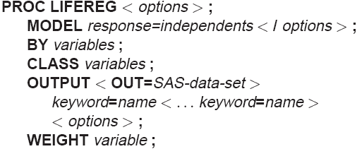
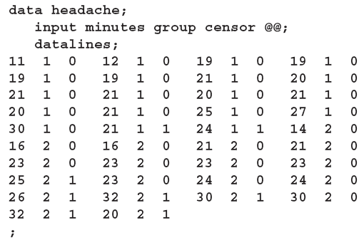
PROC LIFEREG
Suppose you conduct a study of two headache pain relievers. You divide patients into two groups, with each group receiving a different type of pain reliever. You record the time taken (in minutes) for each patient to report headache relief. Because some of the patients never report relief for the entire study, some of the observations are censored.

Slide 9
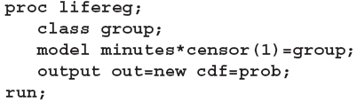
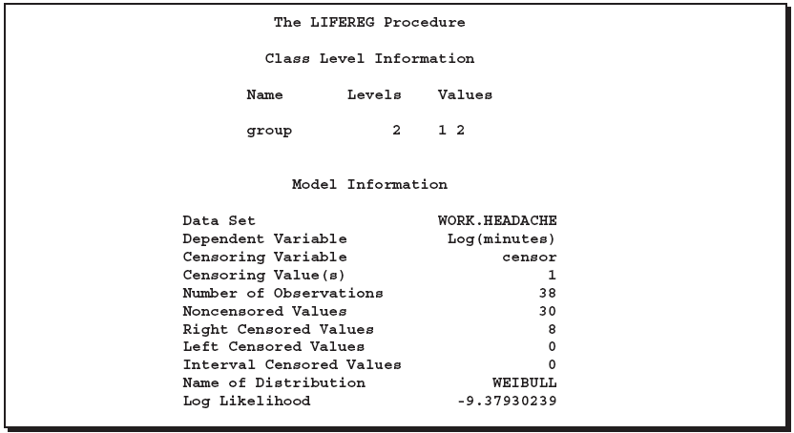
PROC LIFEREG
Log of response is used since Weibull Model is selected
Log Likelihood value is calculated as per the formula. This must be used to compare different model’s goodness of fit to the data.
# of observation-#censored = 38-8=30
Model distribution type selected as Weibull by default

Slide 10
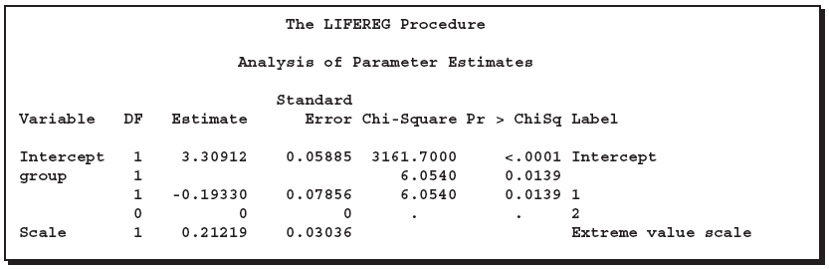
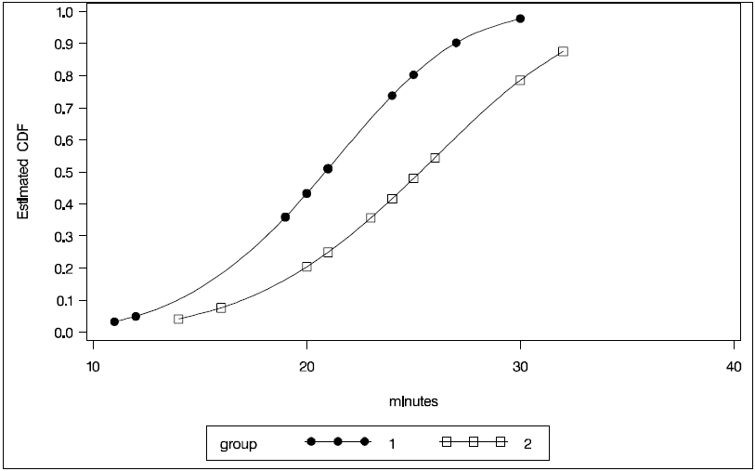

PROC LIFEREG
Log(minutes) = 3.30912-0.19330 for group 1 and = 3.30912-0 for group 2
Weibull shape parameter (k) is the reciprocal of scale i.e. (1/0.21219) = 4.7128

Slide 11
PROC LIFETEST
The LIFETEST procedure can be used to compute nonparametric estimates of the survivor function either by the product-limit method (also called the Kaplan-Meier method) or by the life table method.
It also provides two rank tests and a likelihood ratio test for testing the homogeneity of survival functions across strata.
For exploring association between covariates and lifetime variable it can perform two tests: censored data linear rank statistics based on the exponential scores (Log Rank) and the Wilcoxon Score (Wilcoxon Test)

Slide 12
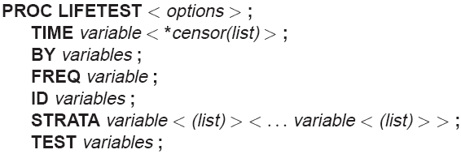
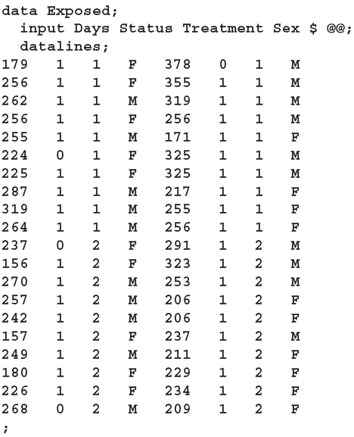
PROC LIFETEST
Consider the results of a small randomized trial on rats. Suppose you assign 40 rats exposed to a carcinogen into 2 treatment groups. The event of
interest is death from cancer induced by the carcinogen. The response is the time from randomization to death. 4 rats died of other causes; their survival times are regarded as censored observations. Interest lies in whether the survival distributions differ between the two treatments. The data set Exposed contains four variables: Days (survival time in days from treatment to death), Status (censoring indicator variable: 0 if censored and 1 if not censored), Treatment (treatment indicator), and Sex (gender: F if female and M if
male).

Slide 13

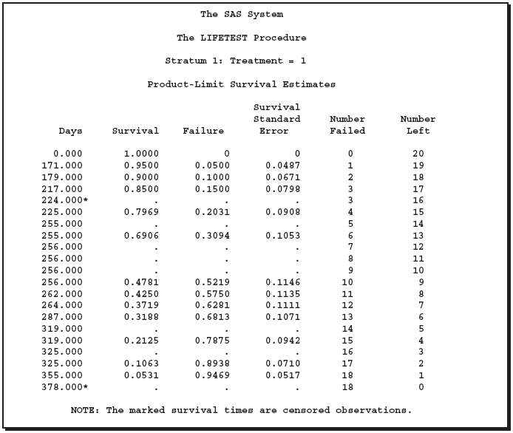
PROC LIFETEST
Multiple Kaplan-Meier Tables are generated by each strata
# Left reduced but # Failed remained the same due to censoring
25% Failure
50% Failure
75% Failure

Slide 14
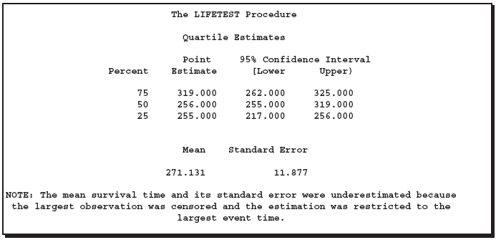

PROC LIFETEST
Estimated as per the previous slide at 25%,50% and 75% failures
Calculated based on weighted average

Slide 15
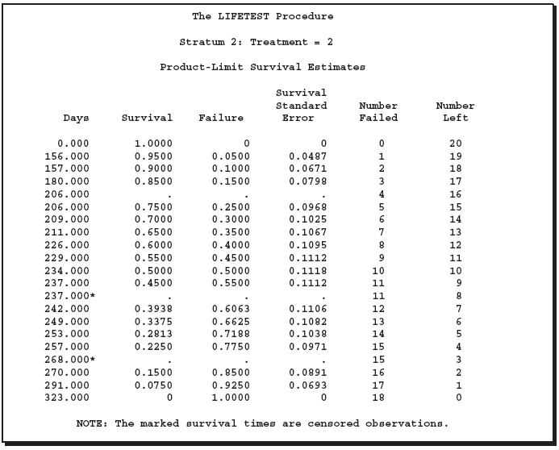
PROC LIFETEST
Similar to output from Stratum 1 but based on data from group with Treatment =2

Slide 16
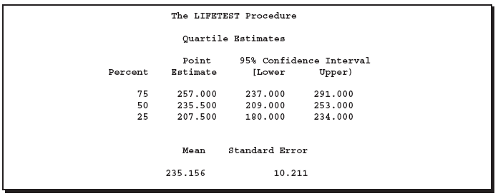
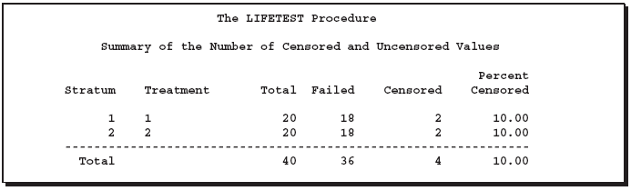
PROC LIFETEST
Summary Table across the stratum enumerating # observations, # failures and #censors

Slide 17
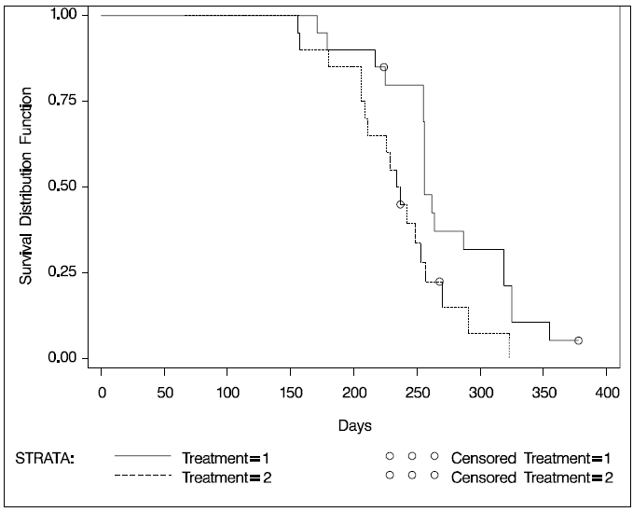
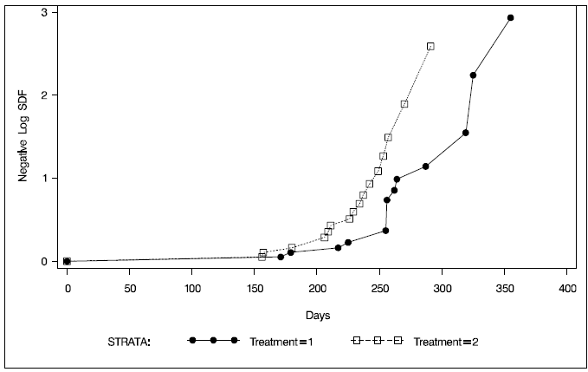
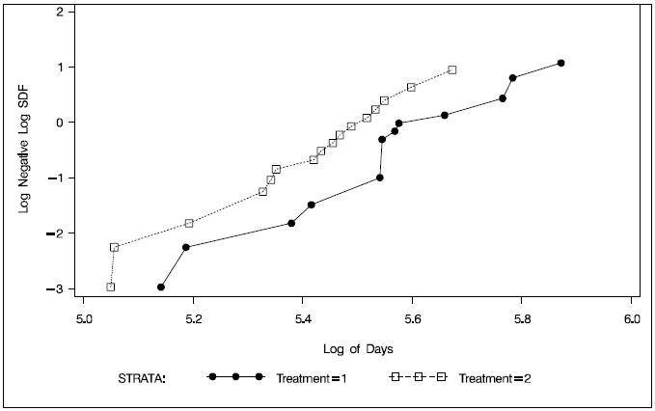
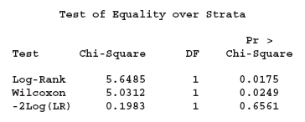
PROC LIFETEST
Kaplan-Meier Curve for survivor distribution Function (SDF) across Treatment stratum
-Log(SDF) across Treatment stratum
Log(-Log(SDF) )across Treatment stratum
Lower the p-value more significantly different they are

Slide 18

PROC PHREG
It assumes a parametric form for the effects of the explanatory variables, but it allows an unspecified form for the underlying survivor function.
The survival time of each member of a population is assumed to follow its own hazard function hence if h₀ changes with time the model fails
The survivor function can be expressed as where is the baseline survivor function
It also allows time-dependent explanatory variables
Procedure includes four methods : Exact, Discrete, Breslow and Efron for handling ties
Procedure provides four model selection methods: forward selection, backward elimination, stepwise selection, and best subset selection

Slide 19
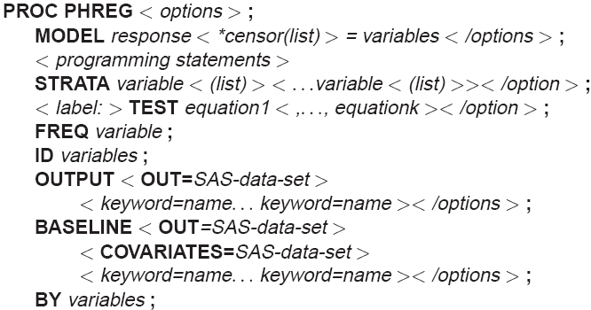
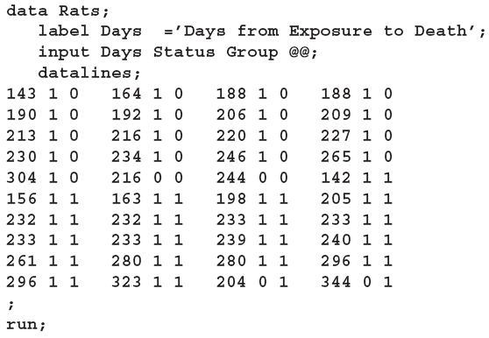
PROC PHREG
Two groups of rats received different pretreatment regimes and then were exposed to a carcinogen. Investigators recorded the survival times of the rats from exposure to mortality from vaginal cancer. Four rats died of other causes, so their survival times are censored. Interest lies in whether the survival curves differ between the two groups.

Slide 20

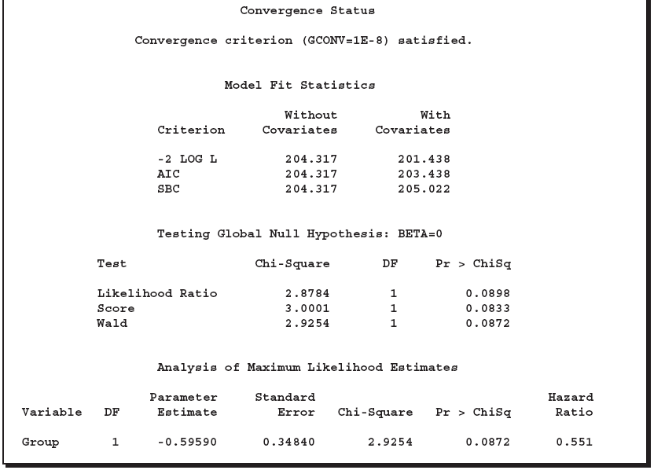
PROC PHREG
Output is identical to logistic regression output though the underlying Likelihood function is different from logistic
h(t) = h₀(t)exp(-0.59590*0) for group 0 and h(t) = h₀(t)exp(-0.59590*1) for group 1
=exp(estimate) =exp(0.59590)=0.551

